Slide 1

Capstone Project:
PJLI Real Estate
www.collaberadigital.com

Slide 2
Personal BACKGROUND
(Name, Past Experience, Qualification, Career Summary)
Name : Delson James M. Tubiera
Past Experience : Freelance Web Developer on Tilden Tasks LLC. dba. WP
Tangerine
Qualification : Full Stack .Net Developer
Career Summary :
Aspiring for the role of .Net Developer wherein I can demonstrate my skills in developing enterprise applications using Microsoft technology stack such as C#, ASP.Net MVC, Web API, WCF etc., along with HTML5/CSS3/JavaScript etc..

Slide 3
Personal BACKGROUND
(Name, Past Experience, Qualification, Career Summary)
Name : Mark Kim Eduard Blas
Past Experience : Internship on HPL Gamedesign Corporation
Qualification : Full Stack .Net Developer
Career Summary : an aspiring Full Stack .Net Developer that showcase my skills and knowledge to develop web applications using HTML, CSS, C#, Asp.Net MVC, Web API, MsSQL.

Slide 4
Key Takeaways/Learnings from the Program (HTD)
Implementation and Connection of MsSQL
ASP.Net MVC
CRUD Operation
Pull and Push in Github Repository
Entity Framework Core
Entity Framework Core: DbContext
Identity Framework
Conventions in Entity Framework Core
One-to-Many Relationship
One-to-One Relationship
Linq-to-Entities Query
Seed Data
Migration
ASP.NET API
Docker
Kubernetes

Slide 5
Problem Statement of the Capstone Project
The real estate industry is facing a challenge of providing a user-friendly and accessible platform for buyers and sellers to search, list, and manage their properties. Traditional methods of buying and selling properties are often time-consuming and complex, with limited options for browsing and comparing properties.

Slide 6
Approach Note
(How the candidate approached the program)
Draw.io for creating diagrams like flowchart, ER Diagram and wireframes
ASP.Net MVC, Web API, MsSQL for developing the web application
Using the real estate website with advanced search options, verified information about properties, and transparent pricing can provide a solution to these challenges. The website can serve as a centralized platform for buyers and sellers to connect and streamline the process of buying and selling properties, leading to increased efficiency and profitability in the real estate market.

Slide 7
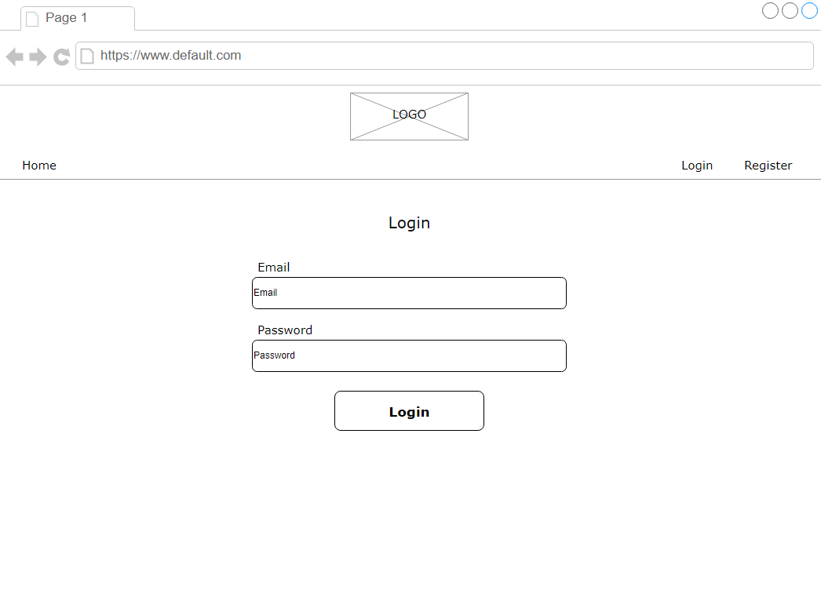
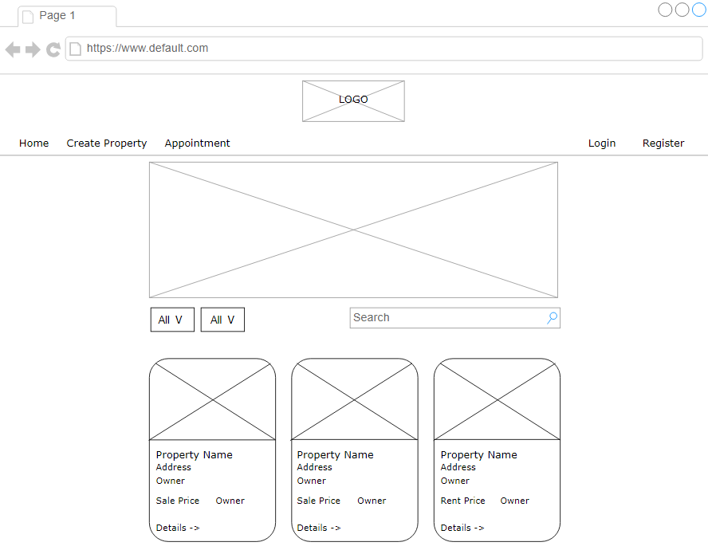
Wireframe/Architecture

Slide 8
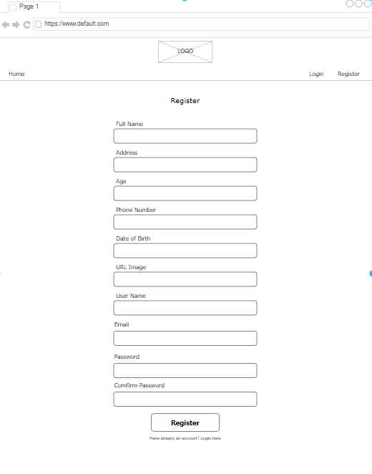
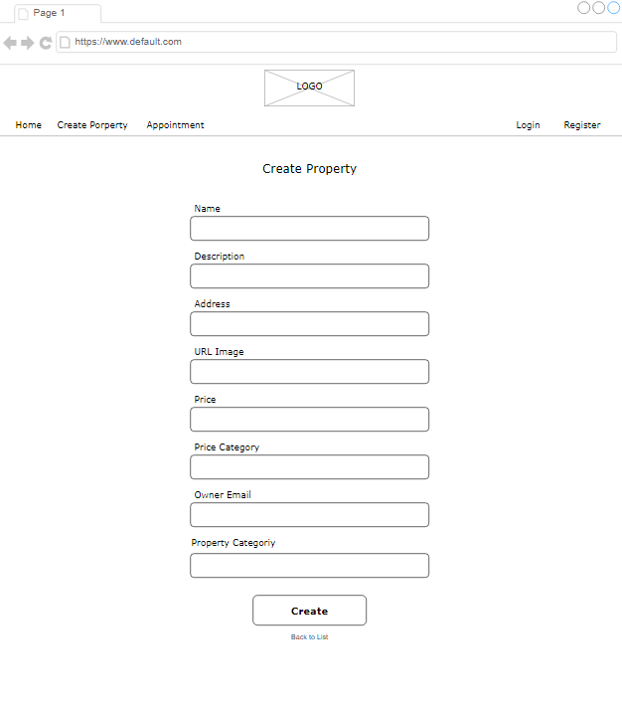
Wireframe/Architecture

Slide 9
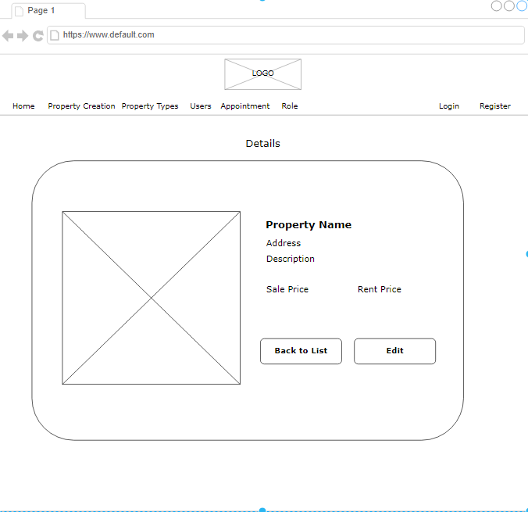
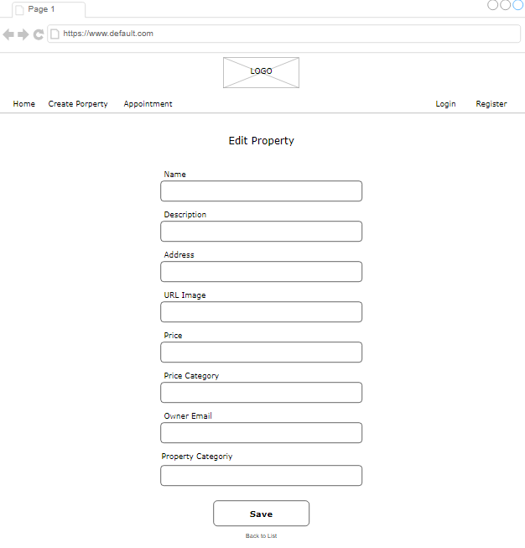
Wireframe/Architecture

Slide 10
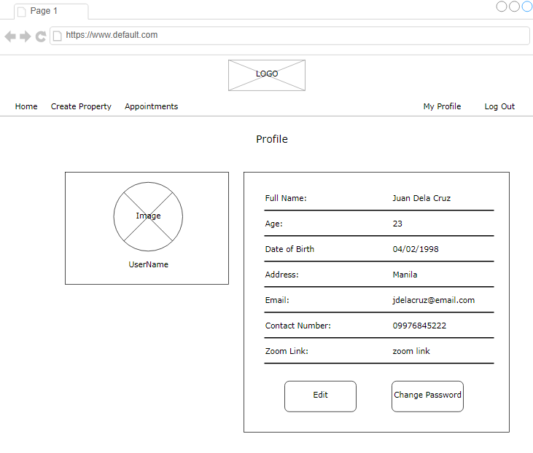
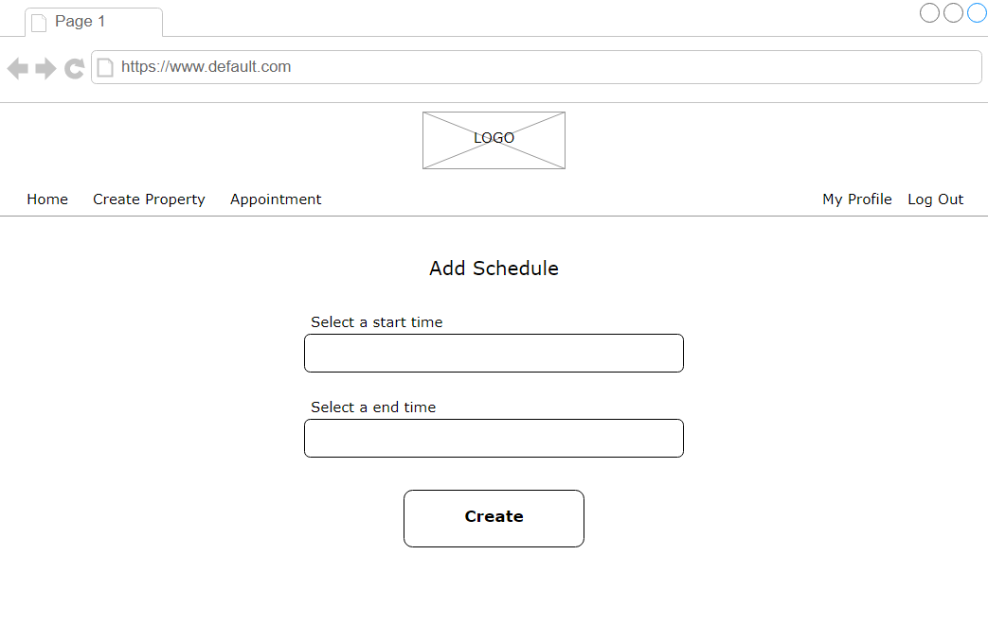
Wireframe/Architecture

Slide 11
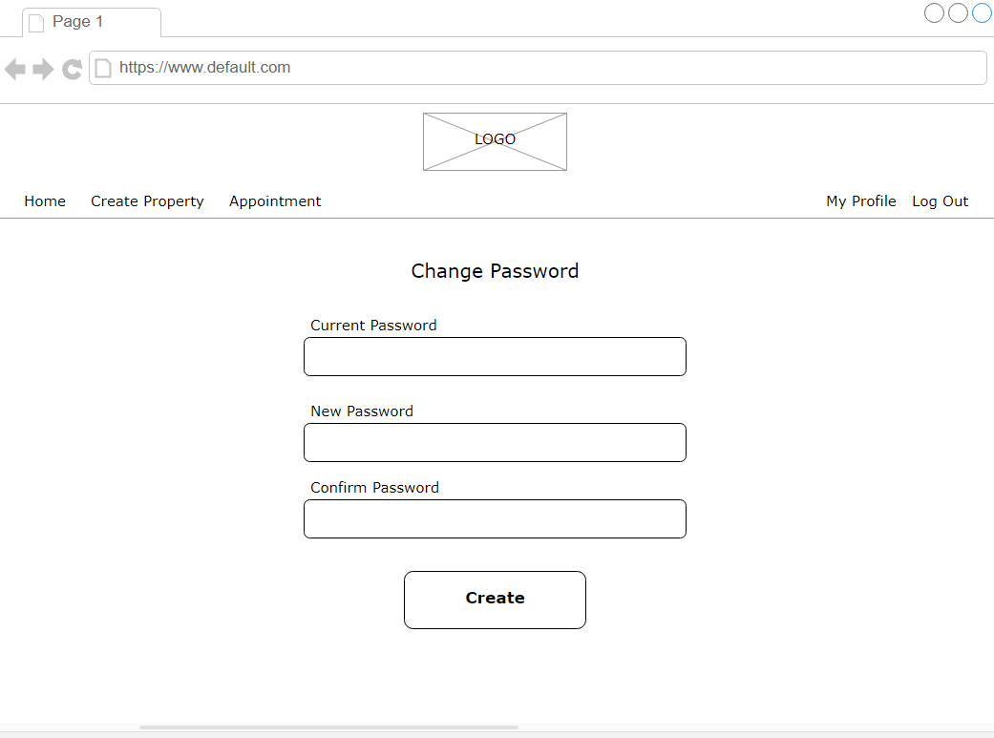
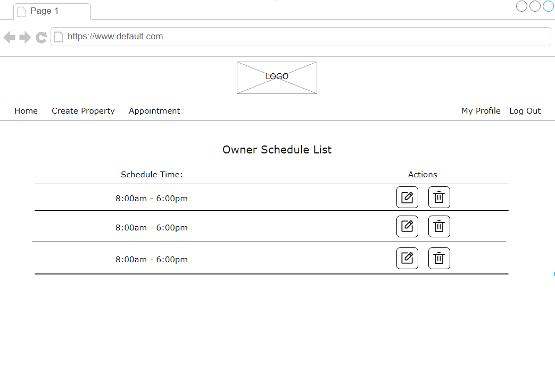
Wireframe/Architecture

Slide 12
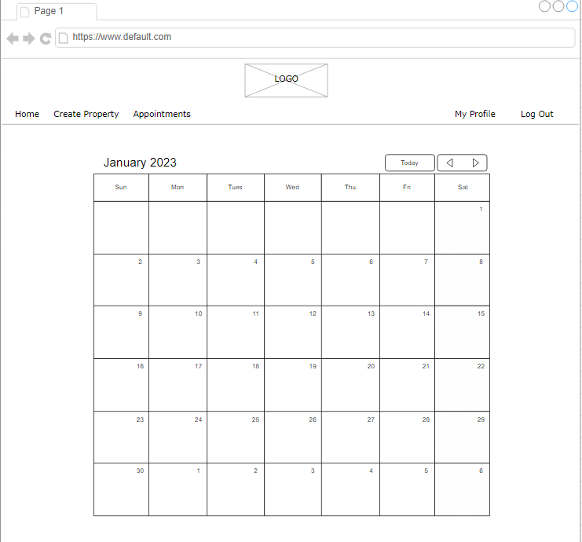
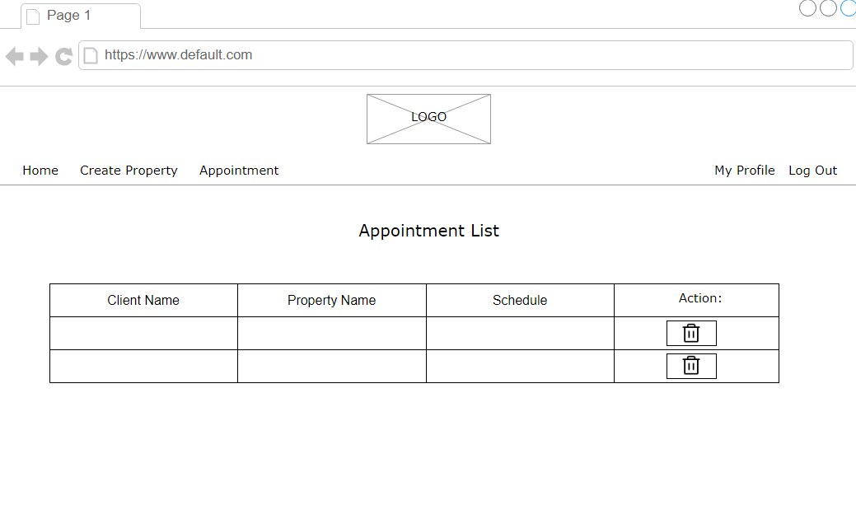
Wireframe/Architecture

Slide 13
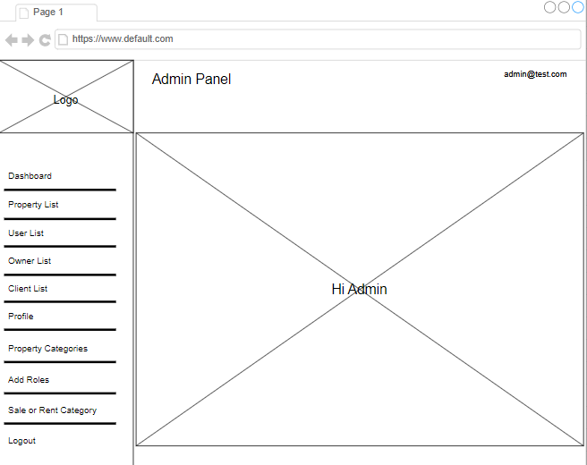
Wireframe/Architecture

Slide 14
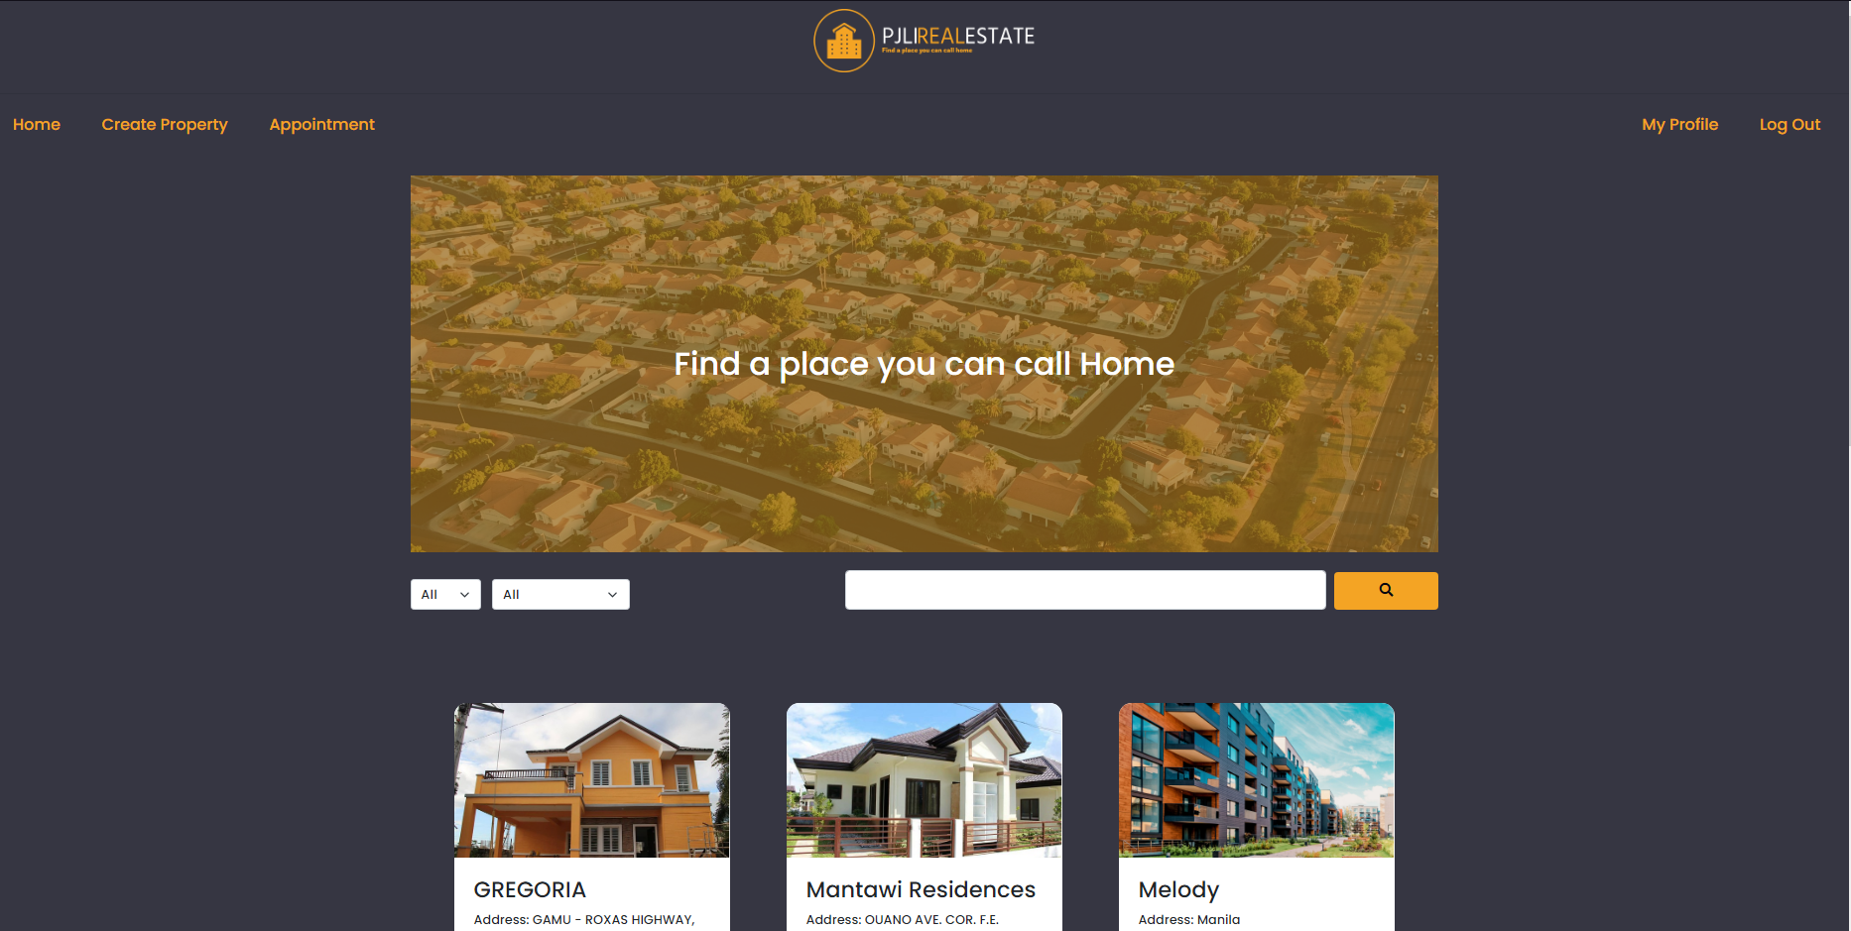
Important areas of the Project with screenshots
(Frontend, Database, Backend, Key Validations, Functionalities Etc.)
Home/Properties

Slide 15
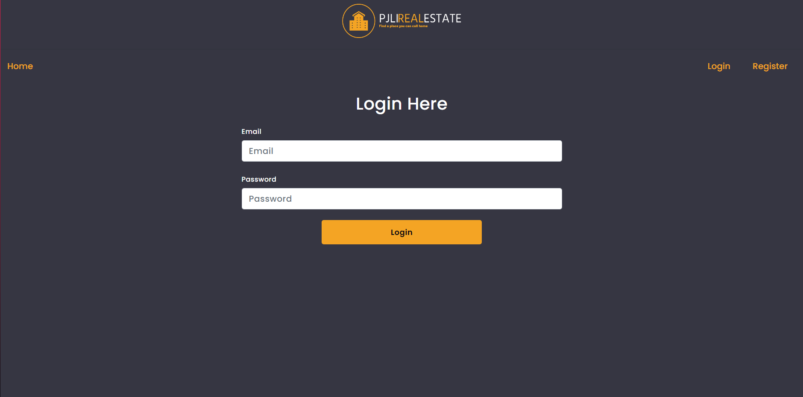
Important areas of the Project with screenshots
(Frontend, Database, Backend, Key Validations, Functionalities Etc.)
Login

Slide 16
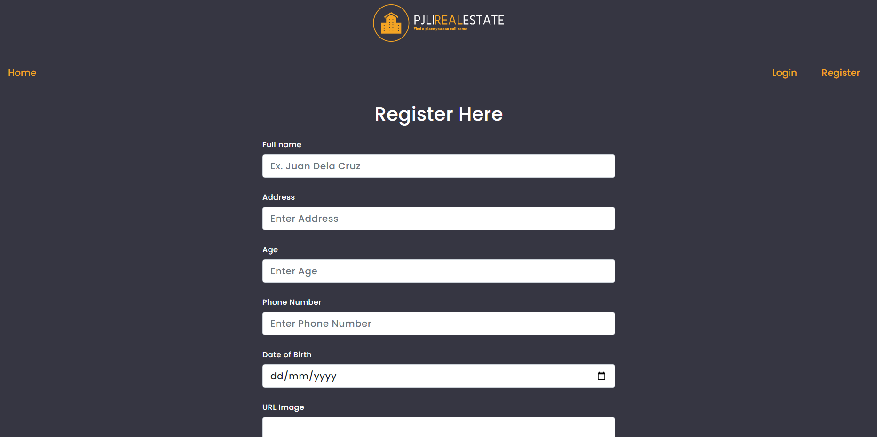
Important areas of the Project with screenshots
(Frontend, Database, Backend, Key Validations, Functionalities Etc.)
Register

Slide 17
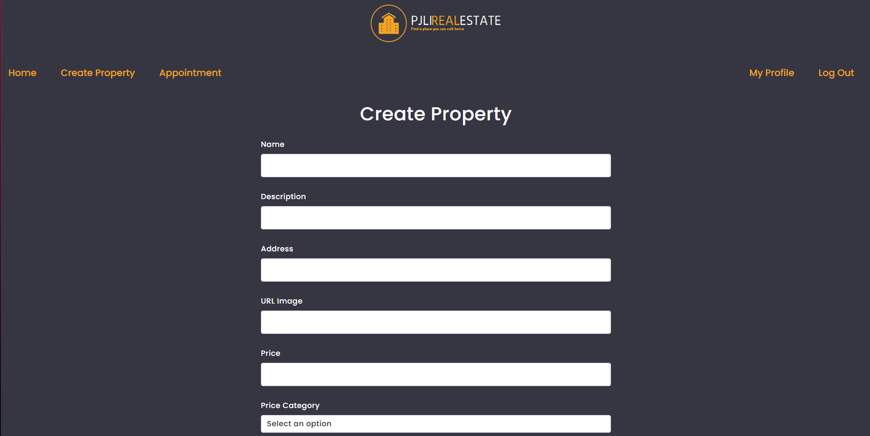
Important areas of the Project with screenshots
(Frontend, Database, Backend, Key Validations, Functionalities Etc.)
Create Property

Slide 18
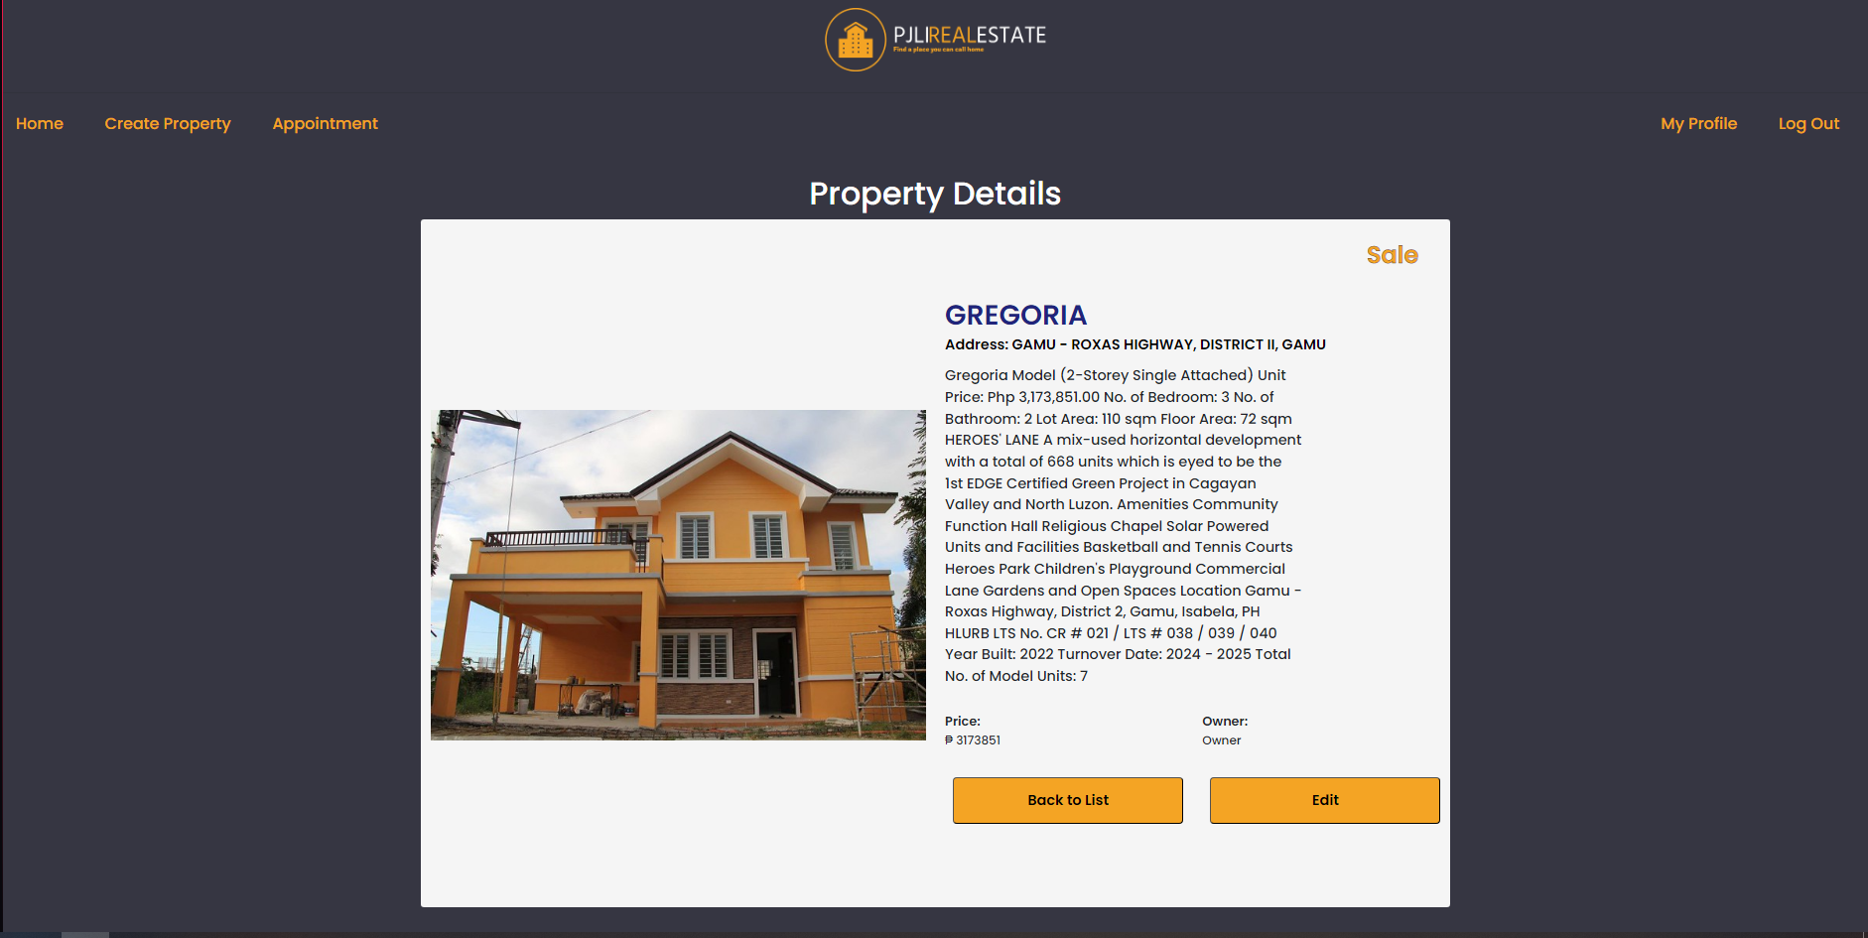
Important areas of the Project with screenshots
(Frontend, Database, Backend, Key Validations, Functionalities Etc.)
Details

Slide 19
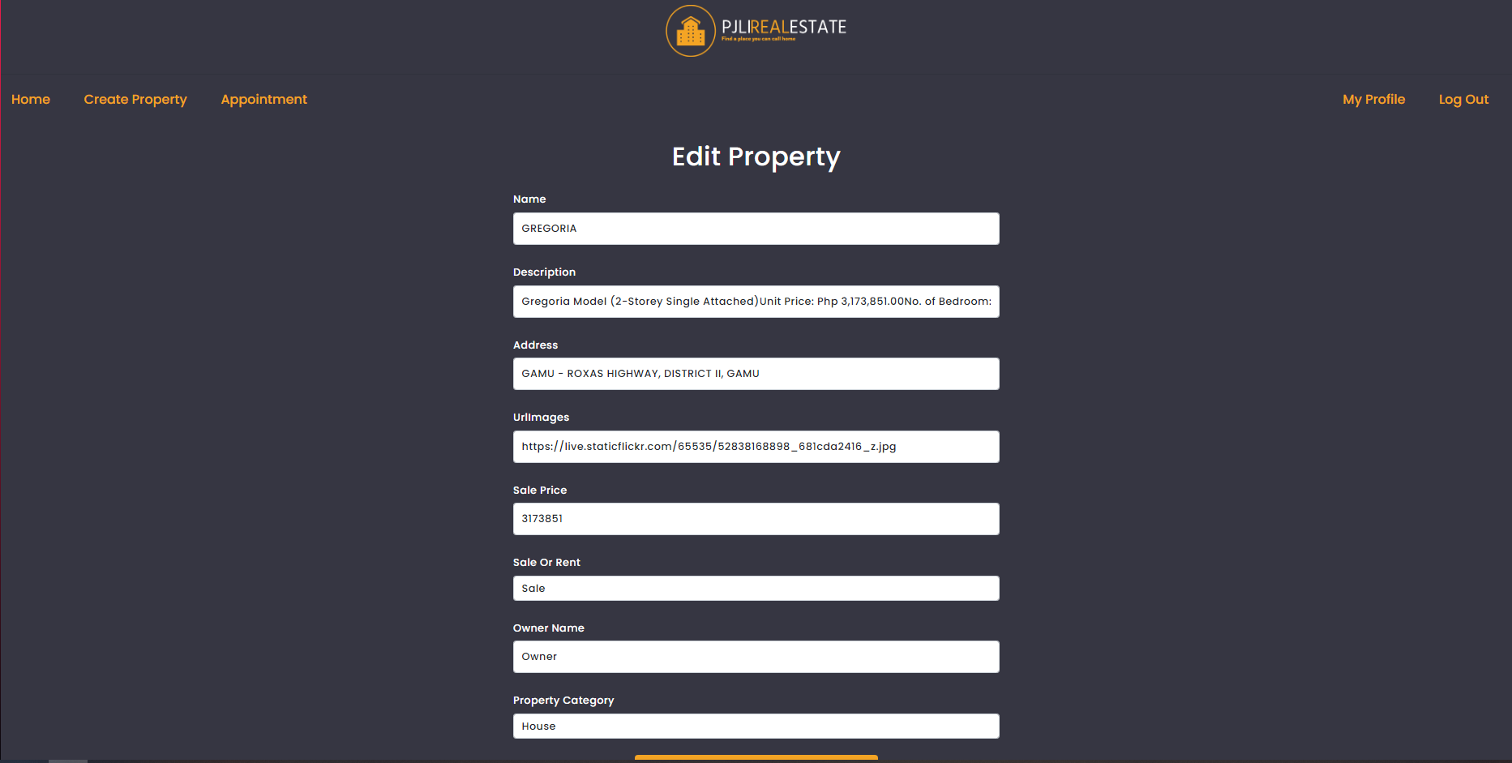
Important areas of the Project with screenshots
(Frontend, Database, Backend, Key Validations, Functionalities Etc.)
Edit Property [owner]

Slide 20
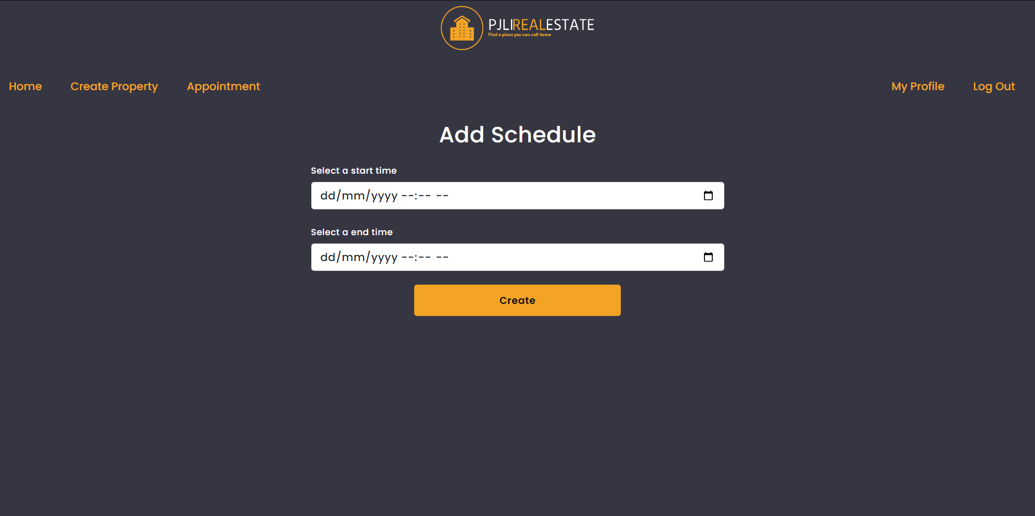
Important areas of the Project with screenshots
(Frontend, Database, Backend, Key Validations, Functionalities Etc.)
Add Schedule[owner]

Slide 21
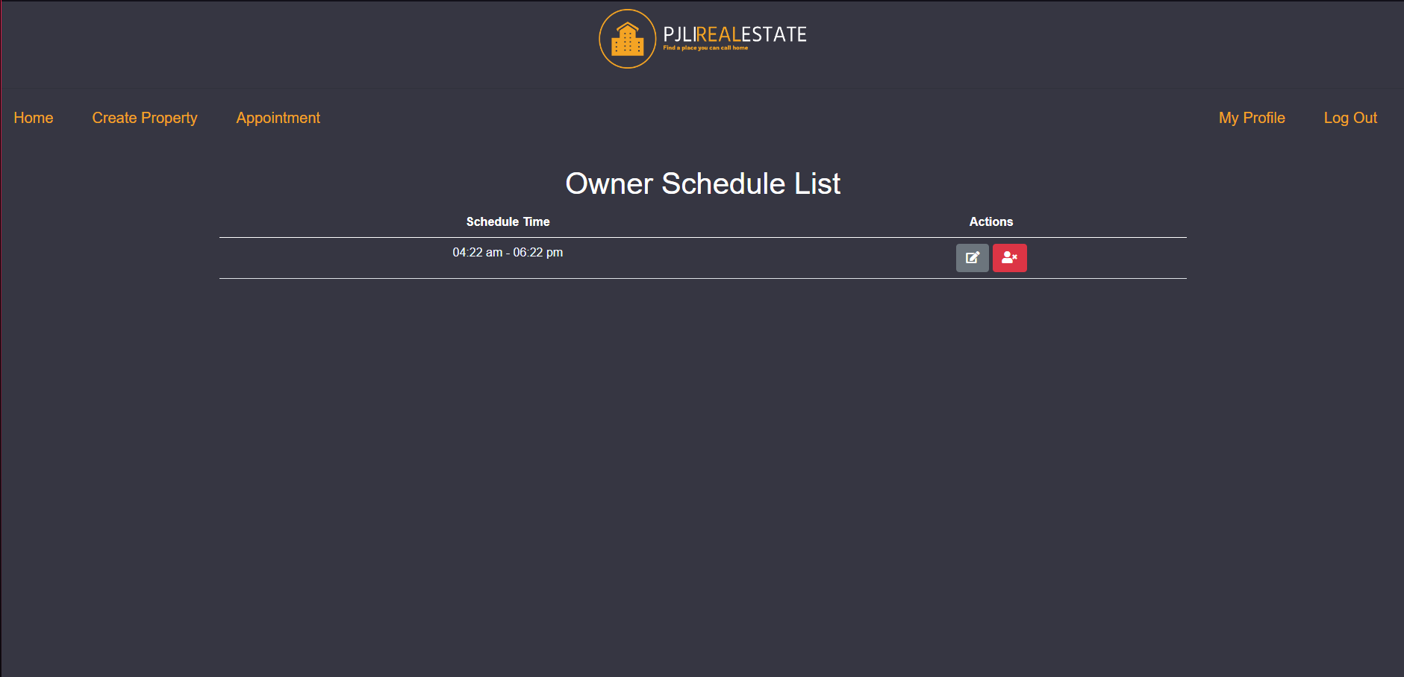
Important areas of the Project with screenshots
(Frontend, Database, Backend, Key Validations, Functionalities Etc.)
Owner Schedule List[owner]

Slide 22
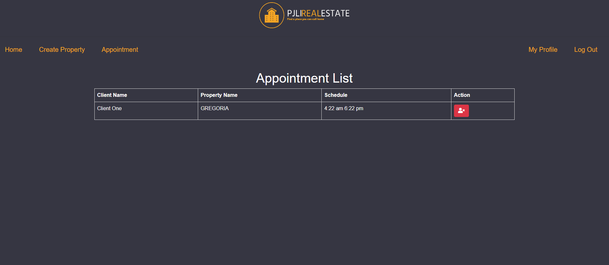
Important areas of the Project with screenshots
(Frontend, Database, Backend, Key Validations, Functionalities Etc.)
Owner Appointment List[owner]

Slide 23
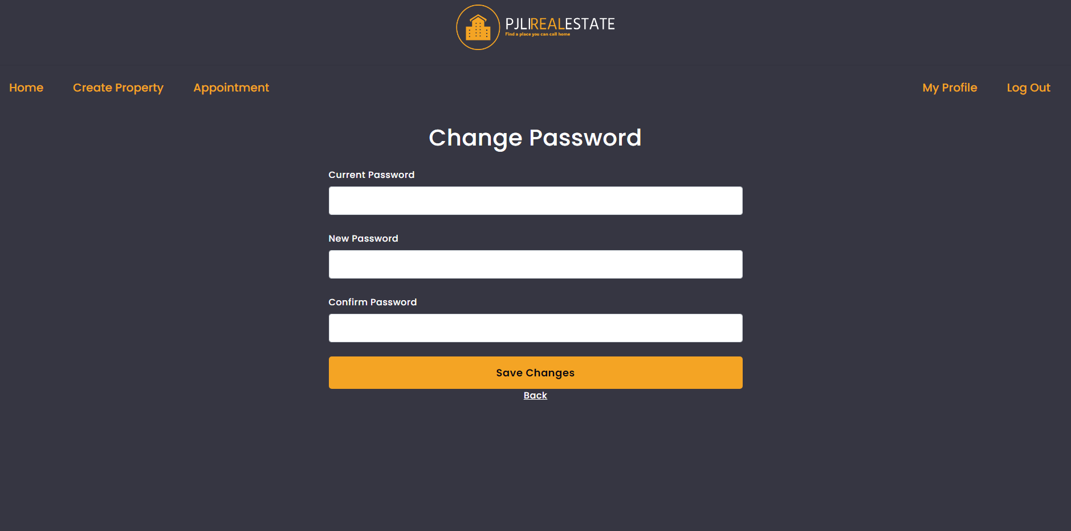
Important areas of the Project with screenshots
(Frontend, Database, Backend, Key Validations, Functionalities Etc.)
Change Password

Slide 24
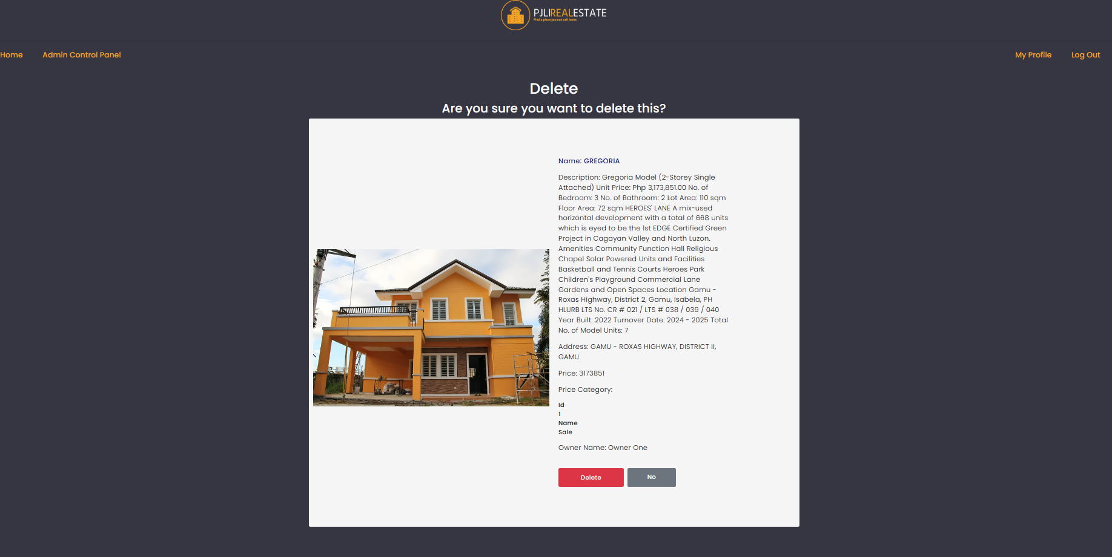
Important areas of the Project with screenshots
(Frontend, Database, Backend, Key Validations, Functionalities Etc.)
Delete

Slide 25
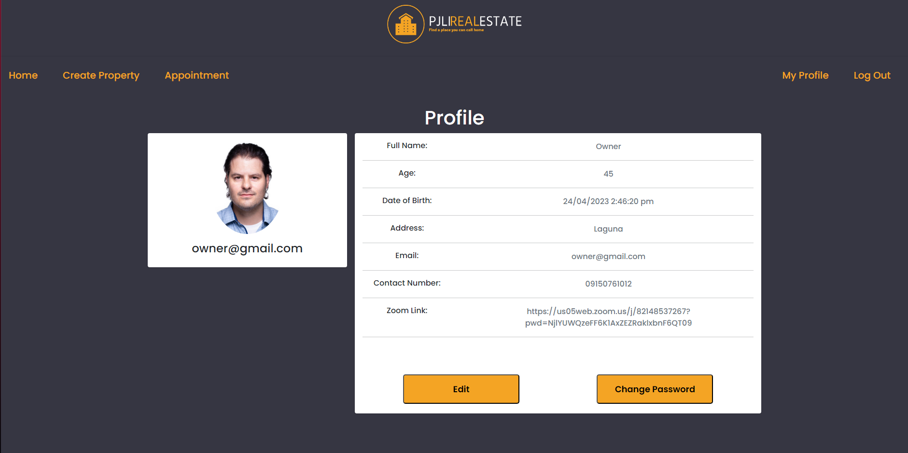
Important areas of the Project with screenshots
(Frontend, Database, Backend, Key Validations, Functionalities Etc.)
Profile

Slide 26
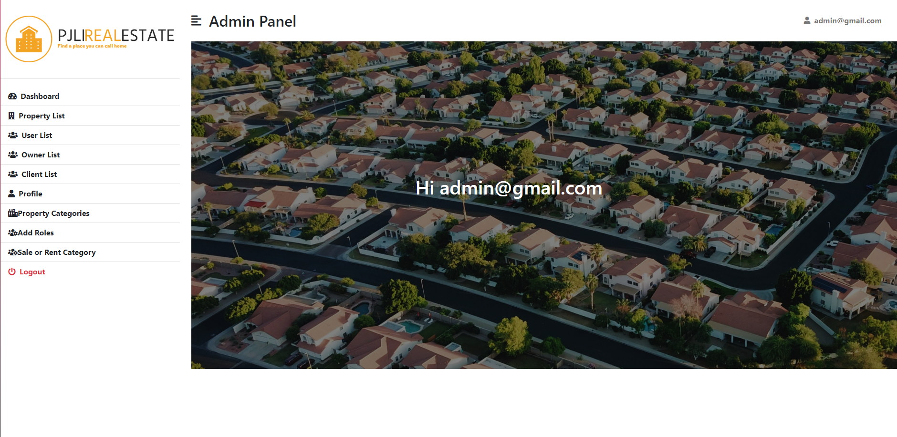
Important areas of the Project with screenshots
(Frontend, Database, Backend, Key Validations, Functionalities Etc.)
Admin Panel

Slide 27
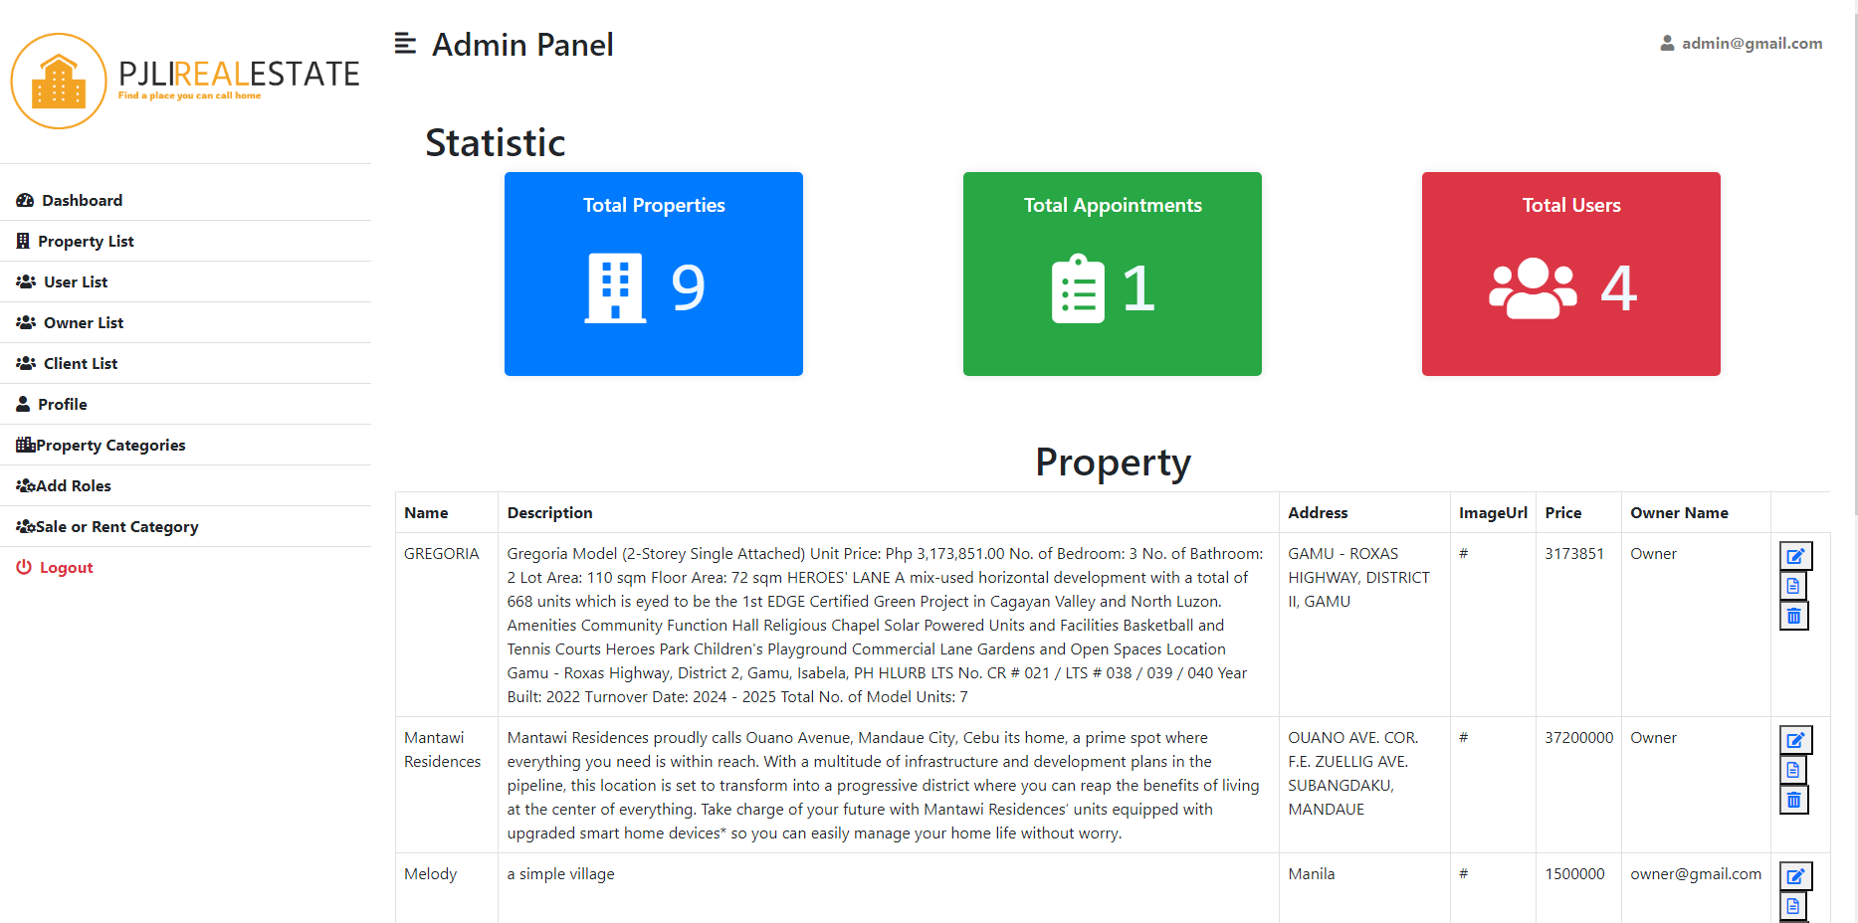
Important areas of the Project with screenshots
(Frontend, Database, Backend, Key Validations, Functionalities Etc.)
Statistics [Admin]

Slide 28
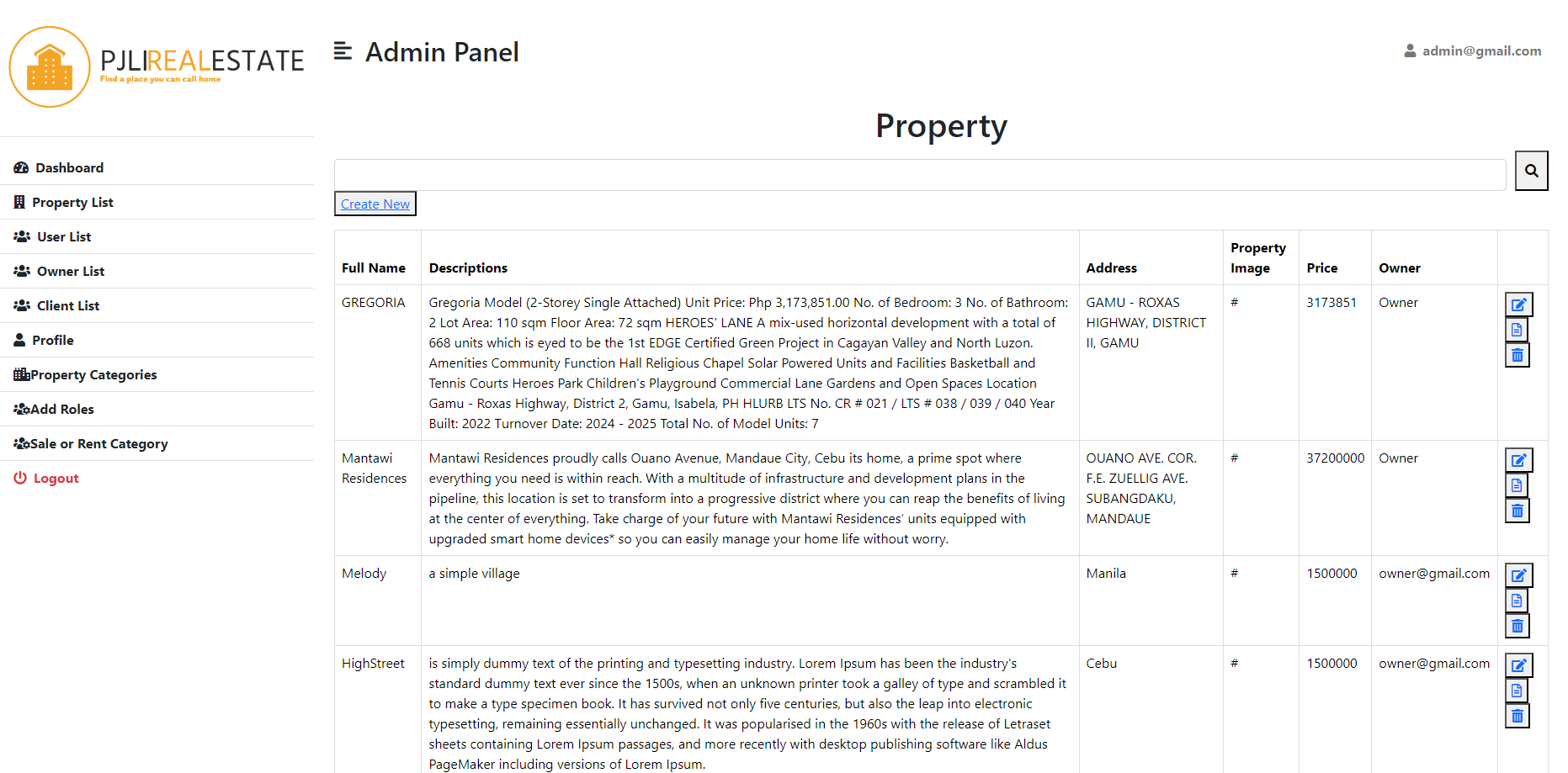
Important areas of the Project with screenshots
(Frontend, Database, Backend, Key Validations, Functionalities Etc.)
Property List [admin]

Slide 29
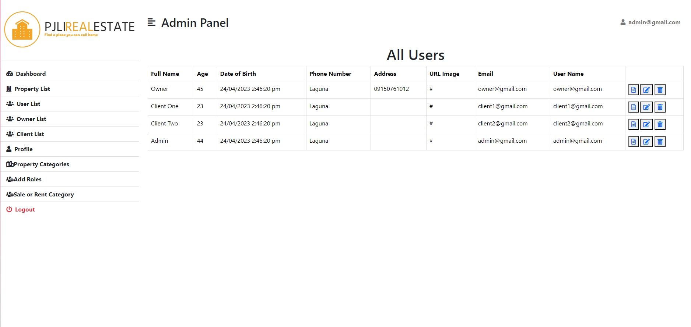
Important areas of the Project with screenshots
(Frontend, Database, Backend, Key Validations, Functionalities Etc.)
User List [Admin]

Slide 30
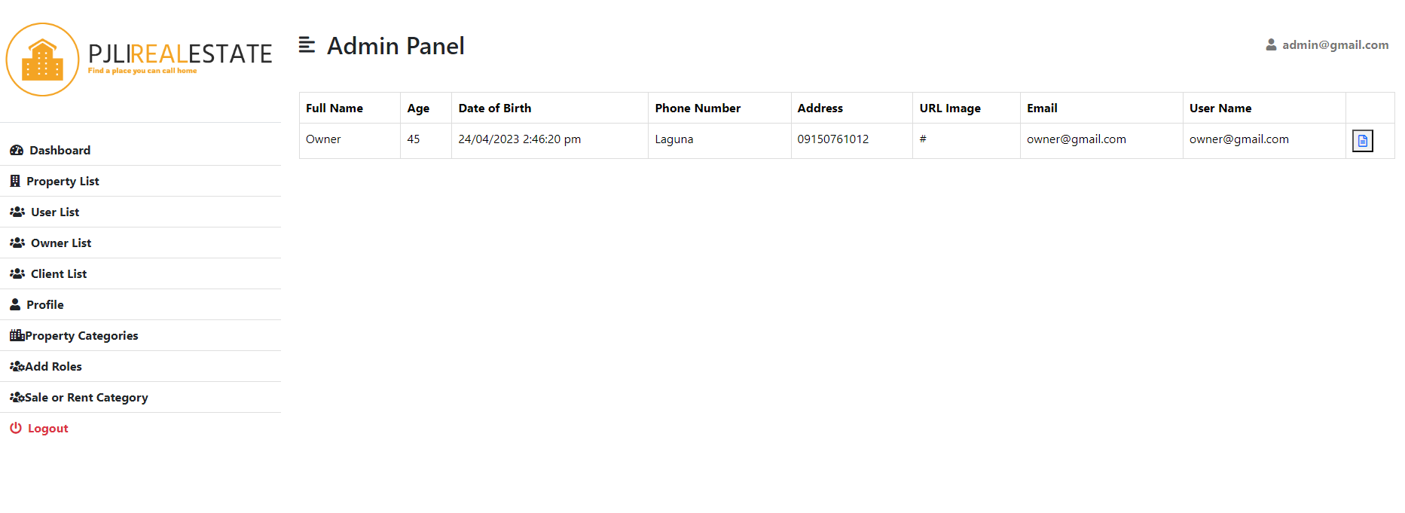
Important areas of the Project with screenshots
(Frontend, Database, Backend, Key Validations, Functionalities Etc.)
Owner List [admin]

Slide 31
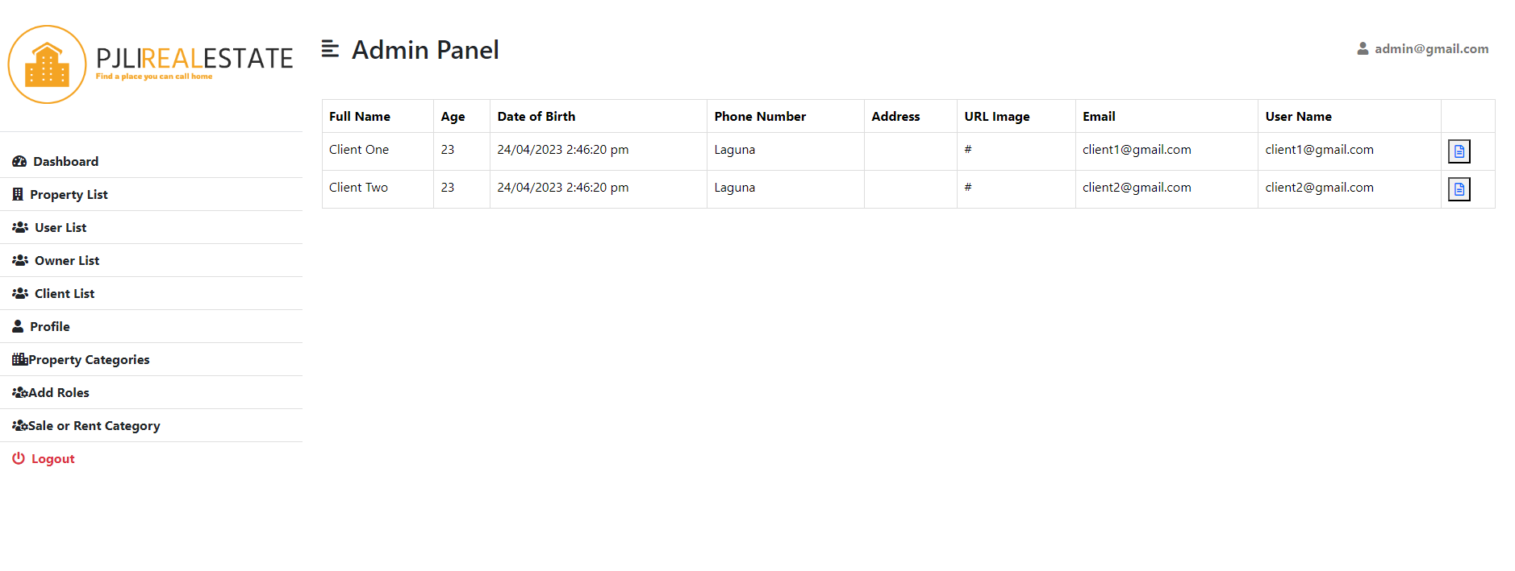
Important areas of the Project with screenshots
(Frontend, Database, Backend, Key Validations, Functionalities Etc.)
Client List [Admin]

Slide 32
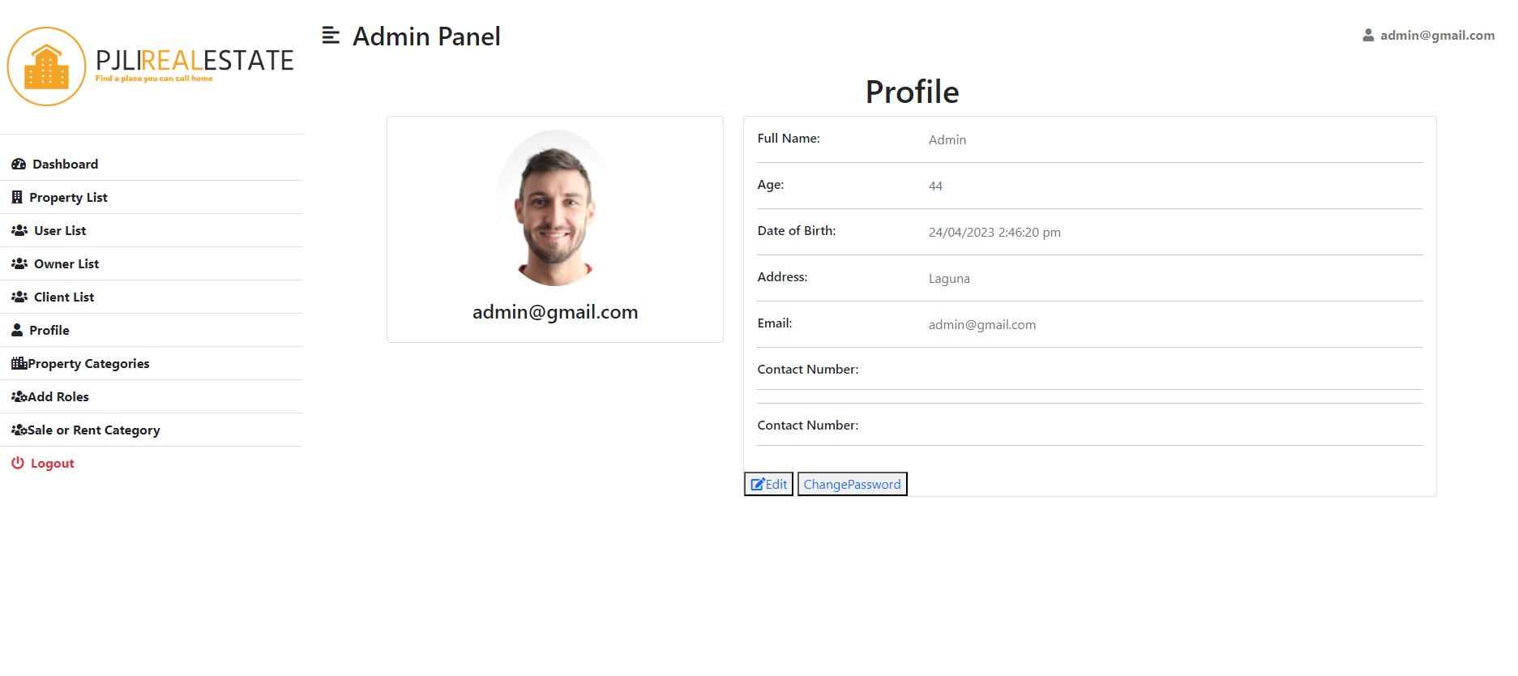
Important areas of the Project with screenshots
(Frontend, Database, Backend, Key Validations, Functionalities Etc.)
Admin Profile

Slide 33
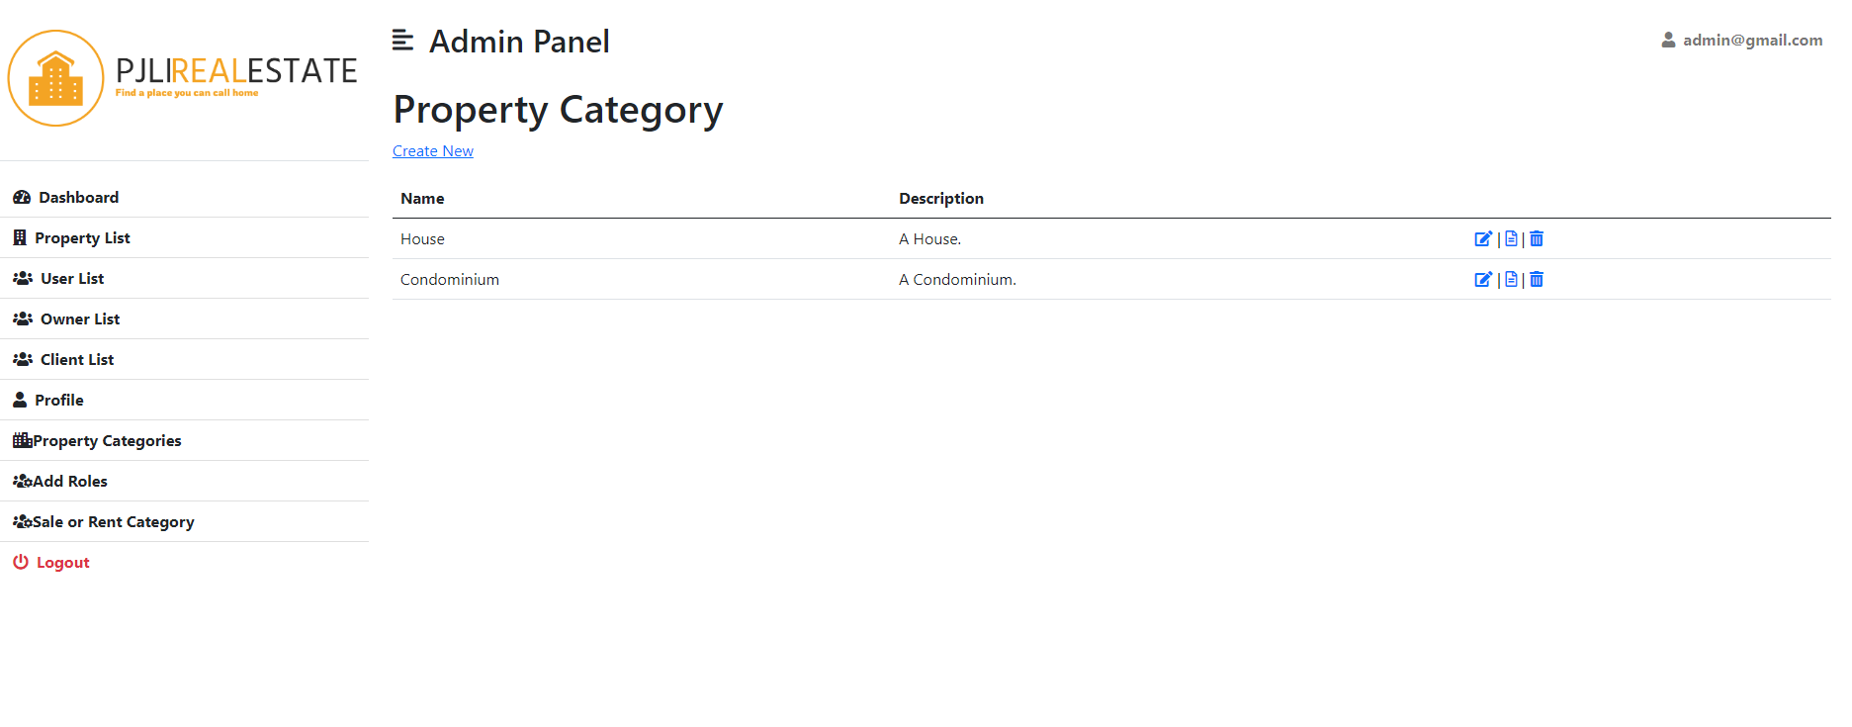
Important areas of the Project with screenshots
(Frontend, Database, Backend, Key Validations, Functionalities Etc.)
Property Categories [Admin]

Slide 34
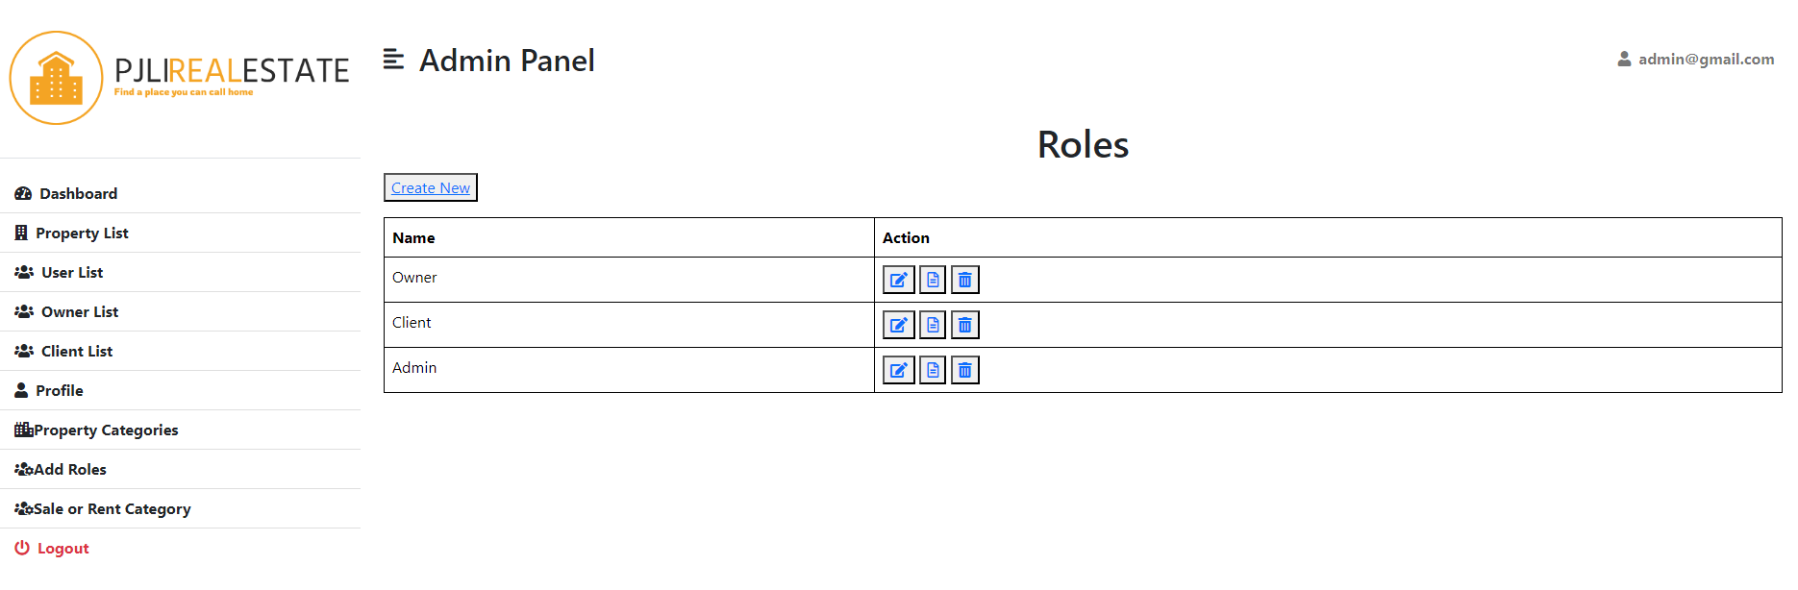
Important areas of the Project with screenshots
(Frontend, Database, Backend, Key Validations, Functionalities Etc.)
All Roles [Admin]

Slide 35
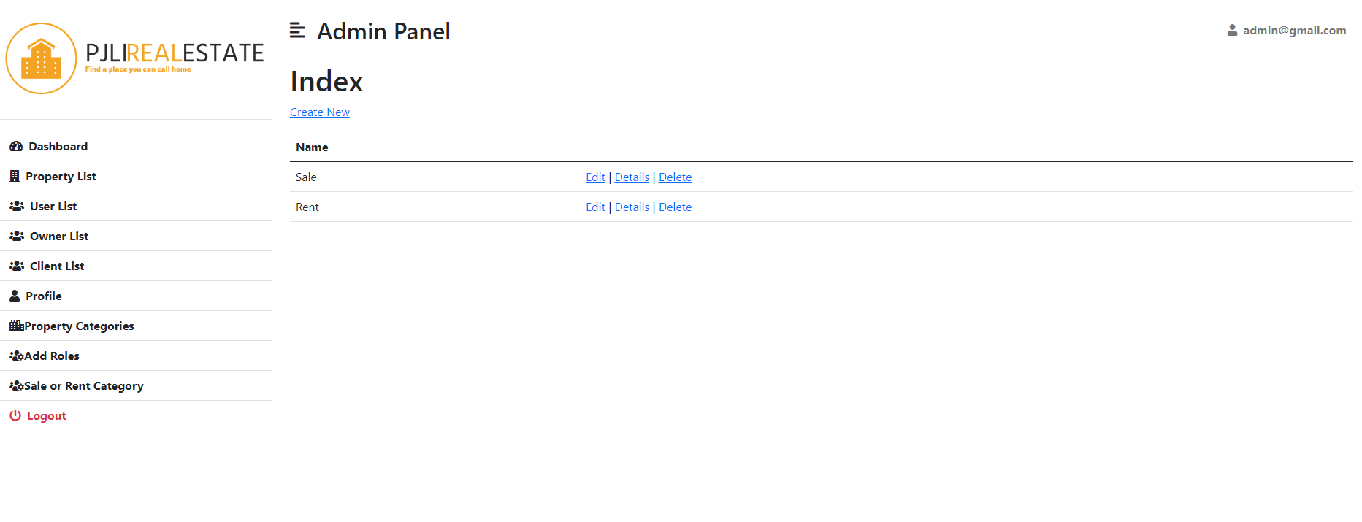
Important areas of the Project with screenshots
(Frontend, Database, Backend, Key Validations, Functionalities Etc.)
Sale or Rent Categories

Slide 36
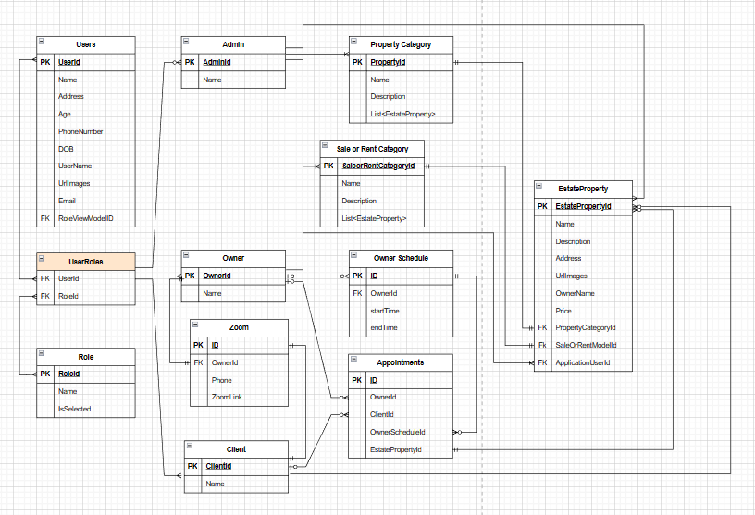
Important areas of the Project with screenshots
(Frontend, Database, Backend, Key Validations, Functionalities Etc.)
ER Diagram

Slide 37
SYSTEM DEMO

Slide 38
FUTURE ENHANCEMENTS:
Maps of all the properties
Notification
Pagination
DIFFICULTIES/CHALLENGES:
Status of Owner if busy or available

Slide 39
Conclusion
In conclusion, both owners and clients can profit greatly from having a real estate website. A real estate website can be utilized to promote properties, draw in potential customers, and promote the purchasing and selling marketing procedure. Additionally, it can offer clients useful information including property descriptions, images, and market trends. To sum up, having a real estate website is an important resource for anyone hoping to be successful in the competitive industry of real estate.

Slide 40
Thank You
www.collaberadigital.com

